Slide 1
Decorator Pattern
Behavioral Design Pattern
Page-117

Slide 2
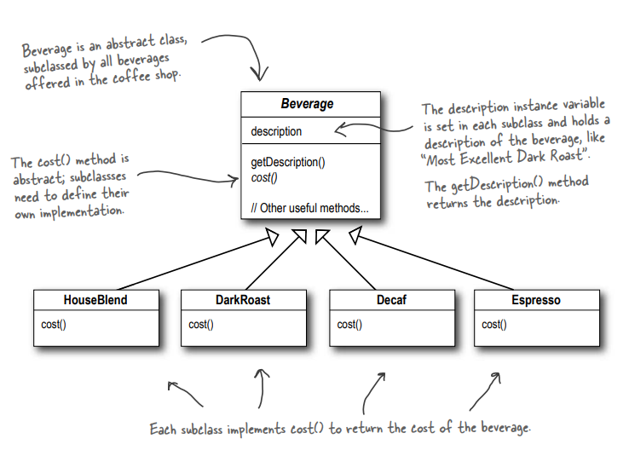
How Beverages are stored in the database in Starbuzz

Slide 3
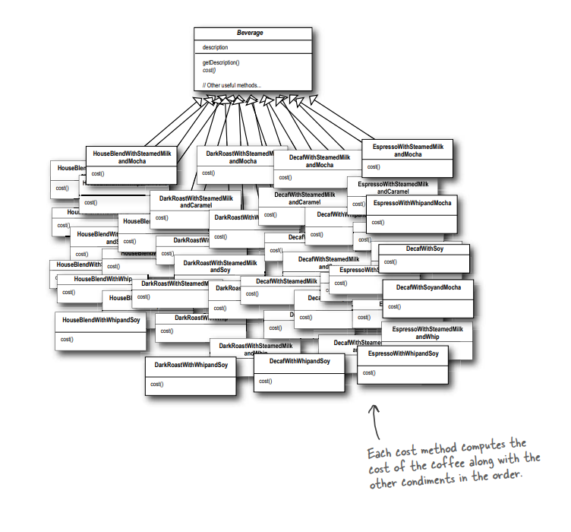
How to model all the variations of beverages ?
An explosion of classes !

Slide 4
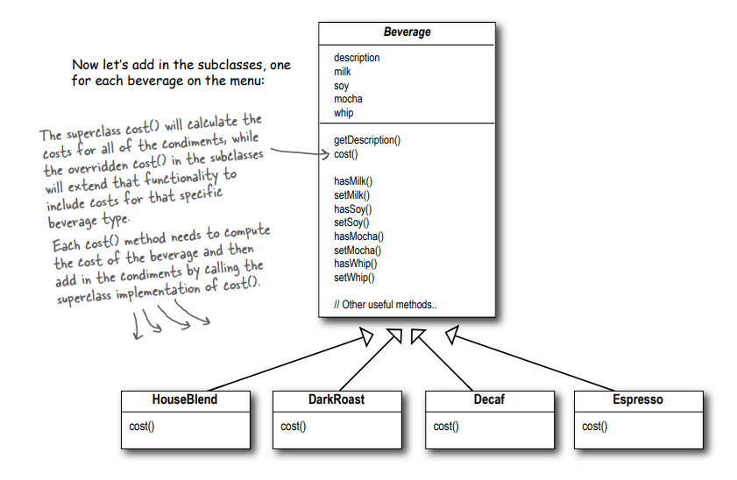
A Possible solution.
Reducing the number of classes, focusing more on the basic types than the variations within same type

Slide 5
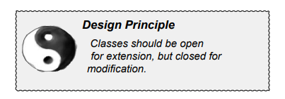
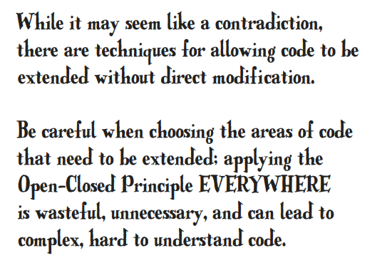

Open Close Principle

Slide 6
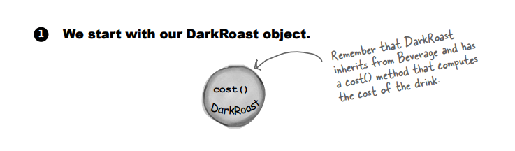
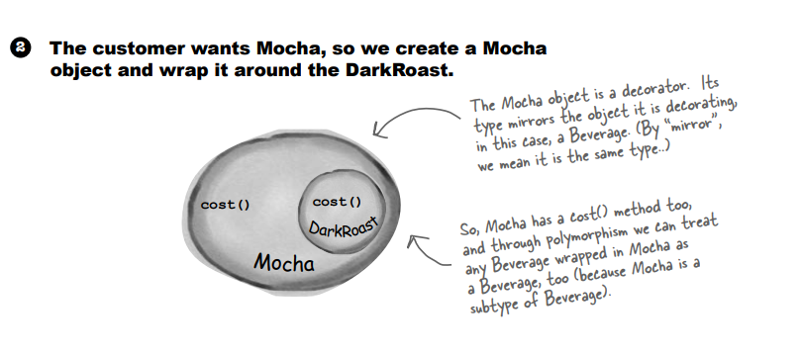
Constructing a drink order with Decorators

Slide 7
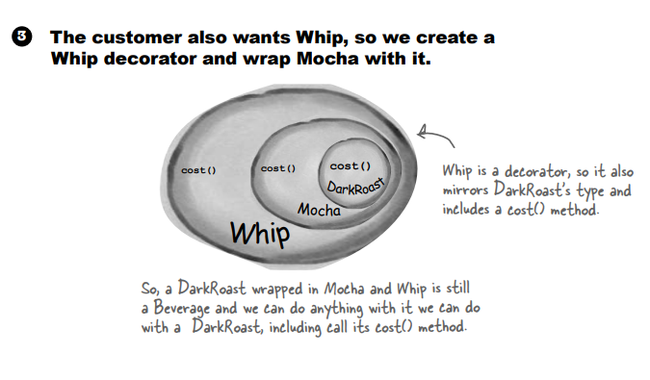

Slide 8
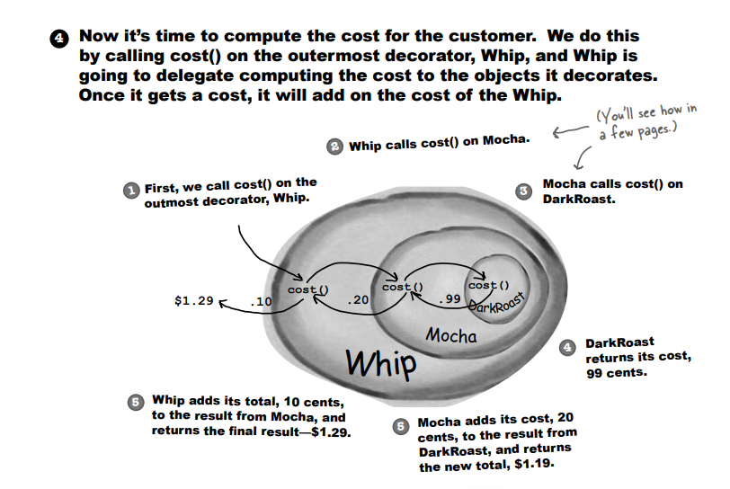

Slide 9
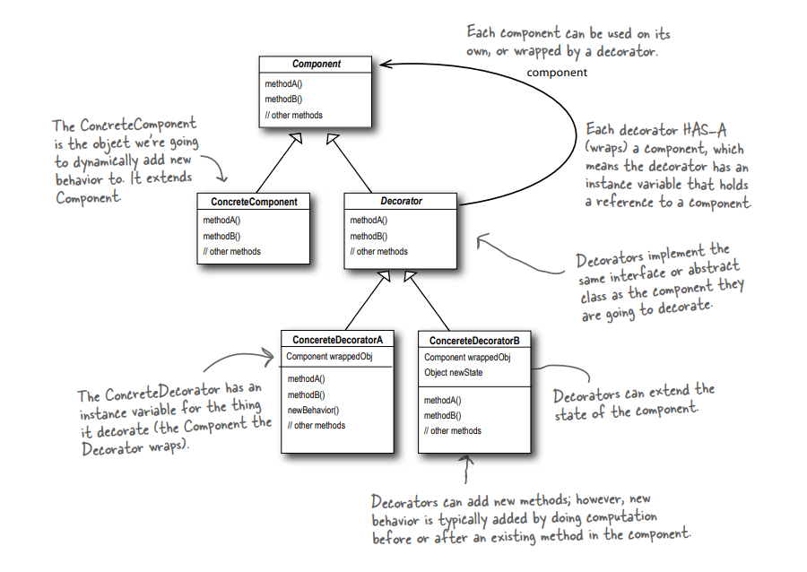
The Decorator Pattern defined

Slide 10
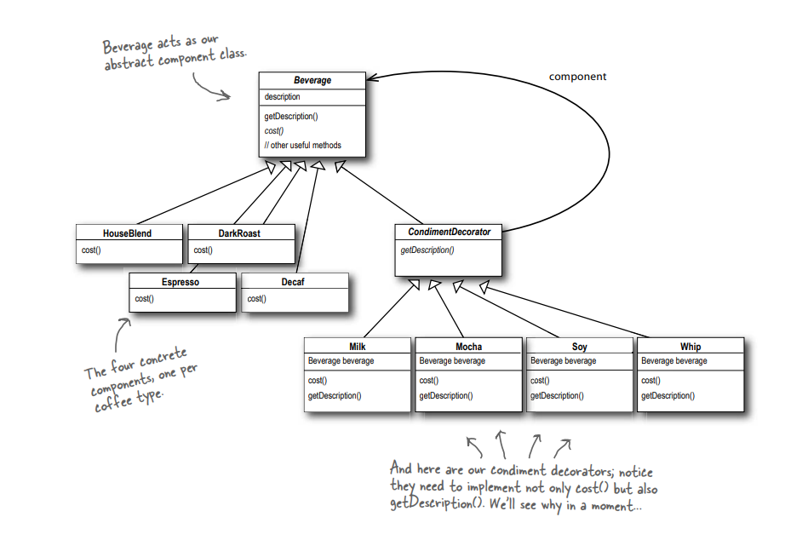
Decorating our Beverages

Slide 11
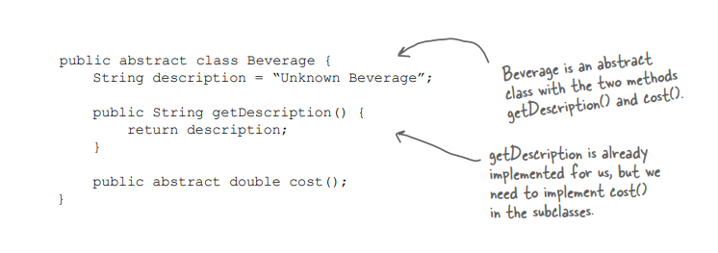
Writing the starbuzz code-1

Slide 12
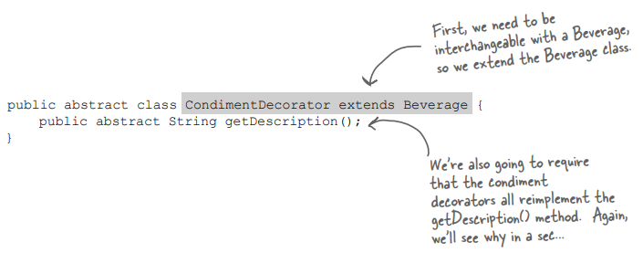
Writing the starbuzz code-2

Slide 13
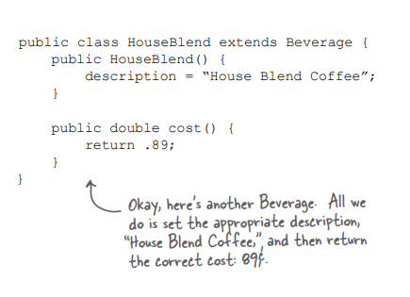
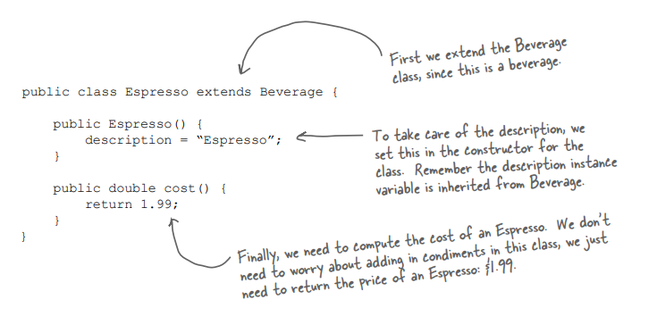
Writing the starbuzz code-2 (Coding Beverages)

Slide 14
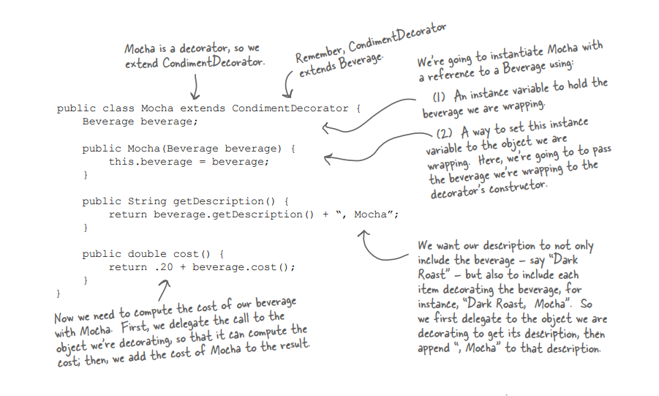
Coding Condiments-1

Slide 15
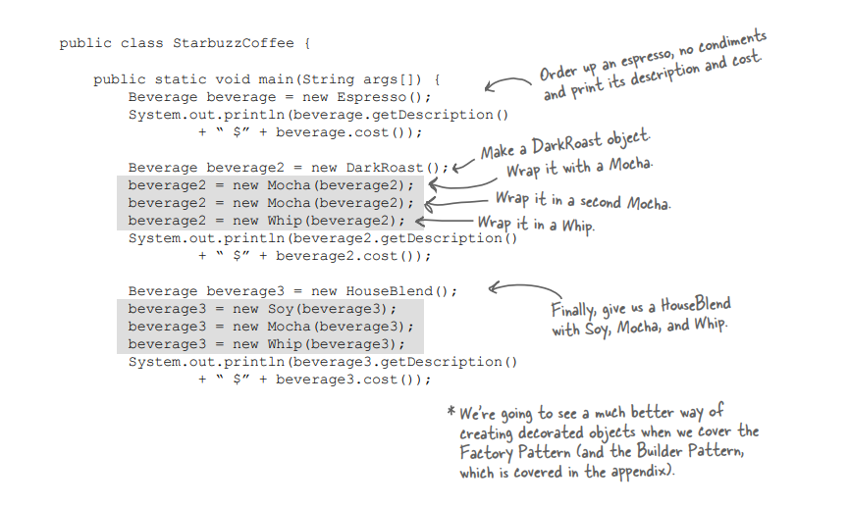
Main Function
Dynamic Behaviour addition

Slide 16
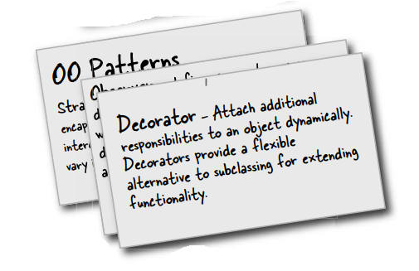
Summary
The Decorator Pattern provides an alternative to subclassing for extending behavior.
The Decorator Pattern involves a set of decorator classes that are used to wrap concrete components.
Decorator classes mirror the type of the components they decorate. (In fact, they are the same type as the components they decorate, either through inheritance or interface implementation.)
Decorators change the behavior of their components by adding new functionality before and/or after (or even in place of) method calls to the component.
You can wrap a component with any number of decorators.

